Slide 1
COVID-19: Partner Toolkit
For the week of April 12, 2020
Last updated April 14, 2020

Slide 2
Objective & Key Message
The more people prepare before they apply,
the faster they will get their benefits.

Slide 3
Key tools to share
Tool | Purpose | Link
COVID-19 Action Alerts | An email list-serv through which we’re distributing instructions and updates on how to prepare and when to apply for unemployment benefits | https://public.govdelivery.com/accounts/WAESD/signup/15249
Eligibility Checker | Helps workers identify whether they’re eligible now for unemployment insurance or for the upcoming CARES act expanded unemployment assistance | https://esdorchardstorage.blob.core.windows.net/esdwa/Default/ESDWAGOV/Unemployment/UIEligibilityChecker.pdf
Application Checklist | Steps people through all they need to have available/done so they can be maximally ready when they apply | https://esdorchardstorage.blob.core.windows.net/esdwa/Default/ESDWAGOV/Unemployment/COVID-19_Applications_CheckList.pdf
SAW Video | One of the biggest challenges people have faced is just signing up for an account. This video helps them do it smoothly | https://youtu.be/JgrLhqbtHQ4
FAQ | 60% of calls into our call center have been questions – most of which we answer in our FAQ. Start there before you call if you have a question. There’s one for workers and one for employers | Worker: https://esd.wa.gov/newsroom/covid-19-worker-information Employers: https://esd.wa.gov/newsroom/covid-19-employer-information
Weekly Benefit Calculator | This will help people estimate their weekly benefit. Later in this ppt, we have a grid of benefit amounts per salary level (including the $600 expanded benefit) | https://esd.wa.gov/unemployment/calculate-your-benefit

Slide 4
Key Issues and Q&A

Slide 5
Top questions/issues we receive
Question / Issue | Answer / Response
I can’t get through on the phone lines and need help! | Please point people to the website first to answer their questions. If they are asking about a specific claim, they’ll still need to contact customer service
I can’t get through and am worried I’ll miss out on some of my benefits! | Please assure people that they will get paid retroactively to the date of their eligibility. They should go to the website to see if their questions can be answered with the information there first. With questions only, they can also call our 1-800 number or use virtual chat found on www.worksourcewa.com.
When can I get my money from the federal CARES act? | The unemployment benefits from the Federal CARES act will go live on April 18th. Get prepared now by going to ESD.WA.GOV and sign up for the COVID-19 Action Alerts.
I can’t sign-up for a SAW account | Please watch this video. If there are still problems, they will need to call our customer service center.
I’m an independent contractor, what do I need to do? What documentation will I need to submit? | I’m an independent contractor, what do I need to do? What documentation will I need to submit? Go to the ESD.WA.GOV website where there are instructions on what to do and what you need to be prepared to apply

Slide 6
Top issues/questions we receive cont.
Question / Issue | Answer / Response
I applied and haven’t heard back. What’s going on? | There is very high demand – with 1000% increase in call volumes since the crisis began. They are working hard to meet that demand so please check the status on the website and, if you haven’t heard back in a couple of days, try calling.
I’m a gig-worker – what do I do? | Go to the ESD.WA.GOV website where there are instructions on what to do and what you need to be prepared to apply
I’m already on UI – am I eligible for the new benefits? Do I need to do anything to access them. | Yes – the Federal CARES act includes an additional $600/week through the end of July and 13 additional weeks of benefits. Anyone on unemployment benefits will be eligible for those additional benefits. You do not need to do anything for the $600 but will need to add the 13 weeks to your existing benefits. An email will be going out to existing UI recipients to explain the action they will need to take to access those 13 additional weeks. Please see the website for more information.
How long will it take when I’m approved to get my money? | It is taking 7-10 days – especially since we waived the waiting week
I was approved and got my first amount of money, but haven’t since? What’s up with that? | Once approved, Unemployment Benefits recipients need to file weekly claims

Slide 7
Independent contractors/self-employed
The federal CARES Act expands unemployment benefits to those otherwise not eligible and who have been impacted by COVID-19
This may include independent contractors and self-employed workers
When they apply, they will need to submit wage documentation for the past year
We will post very specific instructions on ESD.WA.GOV for what they should do
To get them their benefits as quickly as possible AND, at the same time, protect taxpayers from fraud, we will pay them right away the minimum weekly benefit amount designated from the federal CARES Act for this expanded unemployment assistance ($235) plus the extra weekly $600 also designated from the federal CARES Act. In other words – they will receive $835 per week until we verify their wage documentation. When verified, we will pay them the full weekly benefit amount for which they’re eligible – including any retroactive payments to the date of their eligibility.
They can speed up that wage verification process by having their documentation ready before applying. We will have suggestions on document types in our instructions, but to give you an idea, the best forms include:
2019 tax filing
1099 forms
Other formal tax documentation

Slide 8
Emerging issues and mitigations
For independent contractors/self-employed workers, the initial weekly benefit amount they will be paid may be different from what the calculator showed and what they expect
To get them their benefits as quickly as possible AND, at the same time, protect taxpayers from fraud, we will pay them right away a minimum weekly benefit amount plus the $600. As soon as their wage documents are verified, we will pay them the full weekly benefit amount for which they’re eligible – including any retroactive payments to the date of their eligibility.
We are both increasing staff as well as using staff time from across ESD for the first two weeks to address the surge of demand for wage verification that we’ll need
High demand may still cause performance issues on our phones, in our account sign-up system and through our online application
We have made our website instructions and Q&A much more robust and are trying to route all questions first to our website so we can reserve phones for claimant issues
We have increased our staffing levels for customer service to over 500 this week and 1000 next week
We have increased our bandwidth and server capacity
Especially with the new laws, the application is still complex
We have posted extensive instructions. People should use them. There are many scenarios laid out that should address the majority of situations. If their questions are still not answered, they should call.
It is going to be a 2 step process to apply for the expanded unemployment assistance. To make these new benefits available quickly, it builds on our existing system. Therefore, we first gauge regular eligibility and then, if not eligible, invite them to apply for the expanded benefits.
We have posted extensive instructions. People should use them. There are many scenarios laid out that should address the majority of situations. If their questions are still not answered, they should call.

Slide 9
Email templates

Slide 10
Email templates: general/proactive
Dear XXXXXX:
As you know, this COVID-19 crisis is a historic time. Thank you for playing your part in flattening the curve by Staying Home and Staying Healthy! I realize, however, that for many, this comes with economic hardship. While many have been able to obtain some relief through benefits such as Unemployment Insurance, many others are still waiting or have been ineligible.
For those still waiting:
The Employment Security Department (ESD) has received an unprecedented flood of applications for assistance. They are doing the best they can to meet this need by hiring additional staff, expanding service hours and updating their technology.
Many of the calls they are receiving and that we have received from constituents are now answered on their website (ESD.WA.GOV) where they have been providing up to date information and resources directly addressing the current circumstances of Washingtonians.
Although it may be frustrating, if you have an issue that must be resolved by speaking to an agent, please continue to call. There are thousands of individuals getting through on the phones every day.
It is important to know that, regardless of when you get through you will receive retroactive payments back to your eligibility date.
For those who have been ineligible thus far but are impacted by COVID-19, I have good news and some instructions!
This coming weekend, ESD is updating its technology to enable the new Federal CARES Act. This will
Expand unemployment benefits to those not previously eligible for unemployment insurance, for example, independent contractors, those who are self-employed and those with fewer than 680 hours worked in the past year.
Add $600 on top of a person’s weekly benefit amount
Add 13 more weeks to the someone’s unemployment benefits
For everyone: In addition to reading the FAQs on their website, here are four things you can do right now to stay up to date and to prepare to apply for unemployment, if you haven’t already:
Stay up to date. If you haven’t already, please sign up for ESD’s COVID-19 action alerts. You can do so on the agency’s COVID page (esd.wa.gov/newsroom/covid-19).
Check your eligibility. Learn more about your eligibility and when to apply for benefits using the new eligibility checker. We are encouraging those eligible for regular unemployment to apply now, and newly eligible to wait until after April 18.
Get ready to apply. Download the application checklist.
Set up your account. Watch the tutorial video to set up your account correctly. It is nine minutes long but will likely save a lot of time.
Thank you for your understanding and patience through this difficult time.
Sincerely,
XXXXXXXX

Slide 11
Email templates: 1099s
Coming soon – we will be updating this by Wednesday, April 15th.

Slide 12
Email template: can’t get through
Dear XXXXXX:
Thank you so much for contacting us regarding unemployment insurance benefits. I am so sorry that you are having difficulty getting assistance.
As you know, this is a historic time. The Employment Security Department has received an unprecedented flood of applications for assistance. They are doing the best they can to meet this need by hiring additional staff, expanding service hours and upgrading their technology.
Many of the calls they are receiving and that we have received from constituents are now answered on their website (ESD.WA.GOV) where they have been providing up to date information and resources directly addressing the current circumstances of Washingtonians. They also will be providing information and instructions on accessing unemployment assistance through their new Action Alert newsletter found here.
Although it may be frustrating, if you have an issue that must be resolved by speaking to an agent, please continue to call. There are thousands of individuals getting through on the phones every day.
It is important to know that, regardless of when you get through you will receive retroactive payments back to your eligibility date.
Thank you for your understanding and patience through this difficult time.
Sincerely,
XXXXXXXXX

Slide 13
Email template: specific claim needs
Dear XXXXXX,
Thank you for your email and bringing this to our attention.
During these unprecedented times, the Employment Security Department is inundated with applications, claims, and inquiries. They are putting all their hearts, souls and hard work in to meet the needs of those we all serve.
Unfortunately, because of this exceptional demand, our office is not able to escalate specific claims at this time. To inquire about your claim, you will need to keep trying to reach their Claims Center agents by calling 800-318-6022 during the assigned day(s) based on your question(s) or by utilizing eServices. ESD has expanded hours and is hiring more people to be able to serve you faster.
In the meantime, please visit their COVID-19 Information page for the most up-to-date information and subscribe to email updates about COVID-19 guidance so you receive their alerts as new guidance becomes available.
We ask for your patience and partnership as we adapt to these unprecedented times. We will get through this together.
Sincerely,
XXXXXXXXX

Slide 14
Social media and graphics

Slide 15
Social media suggestions for the week of 4/12
Subject | Proposed language and link | Images to include - see the subsequent pages
Launch of expanded benefits | Expanded unemployment benefits become available in WA April 18. Get an account set-up now & get prepared so that you can be ready! The more prepared, the sooner you’ll get your benefits esd.wa.gov/unemployment | Expanded benefits graphic
Overall – get prepared | Need unemployment benefits? The more prepared you are, the more likely, you’ll get them quickly! 4 things to do right now to prepare to apply esd.wa.gov/unemployment | 4 step graphics
Overall | How to get your unemployment benefits more quickly: PREPARE! Here are 4 Steps to do now to get ready: esd.wa.gov/unemployment | 4 steps graphic
First step | Make sure when you apply for Unemployment benefits that the first step is not a stumble! Sign up for your account NOW to be ready – watch the video 1st and then sign-up! https://youtu.be/JgrLhqbtHQ4 | SAW graphic
All those not currently eligible | Expanded unemployment benefits applications open up soon for those not previously eligible. Click here to get the eligibility checker to see if that’s YOU and use our checklist to prepare. The more prepared you are, the sooner you get the money and benefits esd.wa.gov/unemployment | Eligibility checker image

Slide 16
Images to promote in social channels
Please follow and share our posts:
Twitter @esdwaworks, FB @WashingtonESD, Instagram @washingtonesd
If you want to share yourself – here are images to copy and past or drag and drop into your social media or your email templates

Slide 17
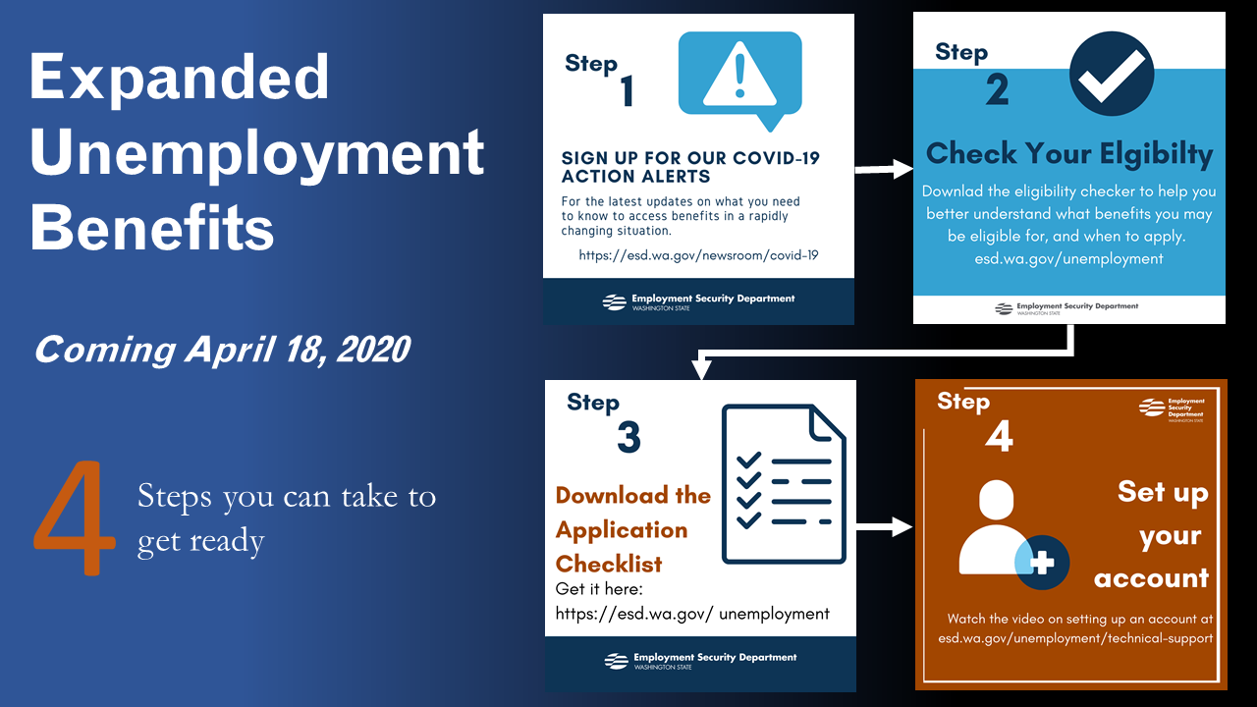
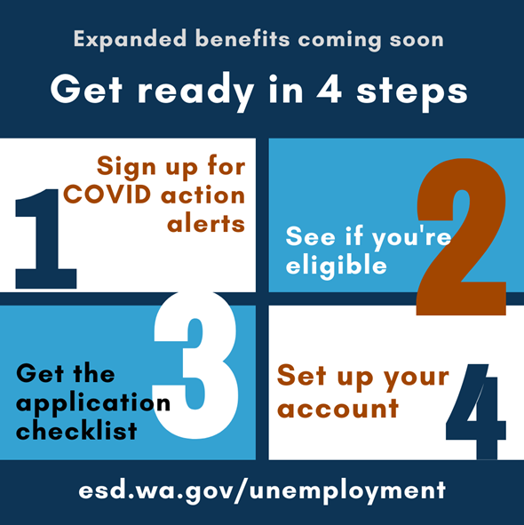
Other Useful Graphics

Slide 18
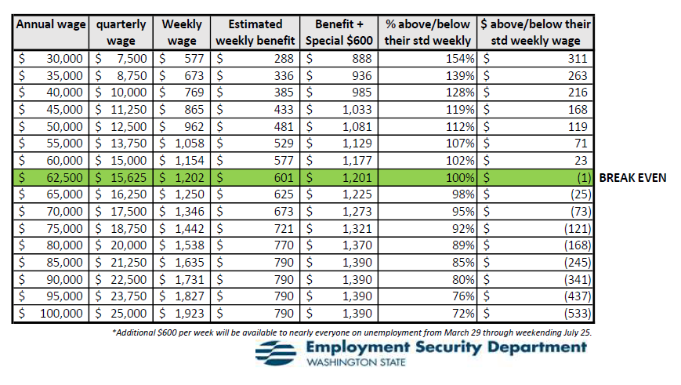
Weekly Benefit Amounts w/the Federal CARES act + $600
People can estimate their weekly benefit amount here: benefit calculator on esd.wa.gov
Note – this provides an estimate. For the actual weekly benefit amount, an individual has to apply

